Slide 1

Team Name :SIGMOIDS
Team Leader Name :SWAMY SETHU SHRUTHI
Problem Statement :AI for Communities, Access & Public Impact
–Build an AI-powered solution that improves access to information, resources,
or opportunities for communities and public systems

Slide 2


Brief about the Idea:
CardSaathi — Bharat’s AI for Every Smart Swipe
“Right card. Right benefit. Right time.”
Problem Statement:
Most Indians miss out on cashback, rewards, and offers every single day.
Not because they don’t have good cards,
but because they don’t know which card to use, when.
CardSaathi fixes that!!!
What It Does :
CardSaathi recommends the best card and live benefit in real time
so every swipe gives you maximum value.
“ Powered by who you are, how you spend, and where you pay. “

Slide 3
CardSaathi — Turning Cards into Smart Financial Assistants
What’s Different Existing solutions passively list offers.
CardSaathi actively recommends the right card at the moment of payment.
How It Solves It
Detects who you are (student, traveler, professional)
Learns how you spend from past transactions
Pops up when it matters most “Use this card now — get more value.”
USP & Impact
More value from existing cards.
Less confusion.
Smarter financial decisions for everyday Indians.
“Turn every swipe into savings.”

Slide 4
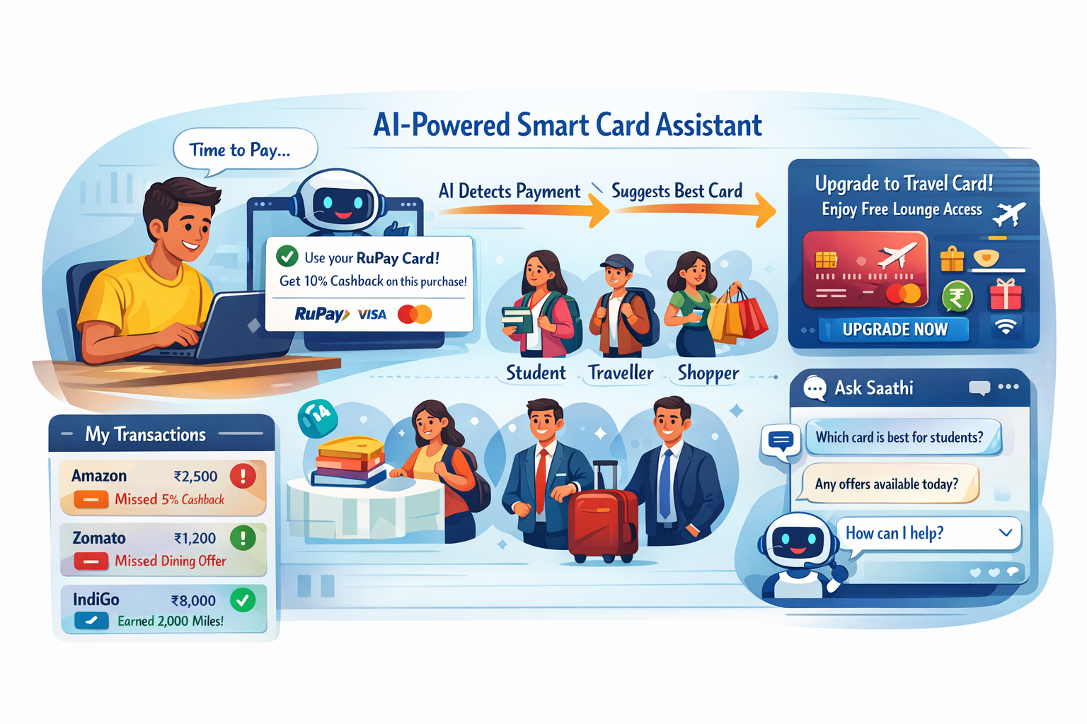
Core Capabilities of CardSaathi
Turning everyday card usage into smart financial decisions.
Real-Time Benefit Activation
AI detects the checkout page and intelligently recommends the card that unlocks the highest live benefit (cashback, rewards, lounge, student offers).
India-First Smart Profiling
Smart profiling for students, travellers, shoppers, and professionals to suggest suitable cards and offers.
Hidden Benefits Discovery
Shows cashback, rewards, OTT, education & travel benefits users usually miss.
Usage-Based Card Upgrade Advisor
AI evaluates long-term spending patterns and recommends
better cards or upgrades at the right time.
Multilingual AI Chatbot
An AI assistant that answers card, offer, and usage queries in simple, non-technical language.
Transaction Insights
Displays past spends and highlights missed benefits to improve future usage.
India-First Card Support
Optimized for RuPay, Indian banks, followed by Visa & Mastercard.

Slide 5
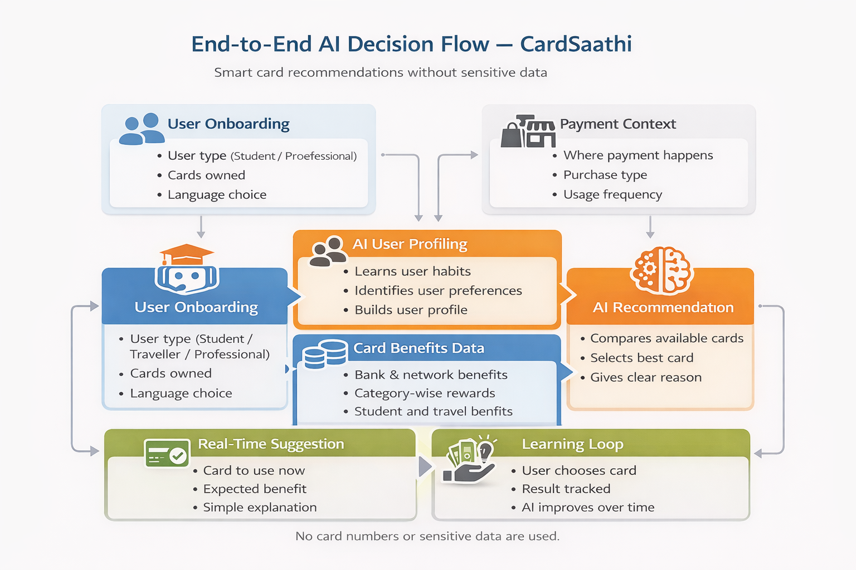

Slide 6
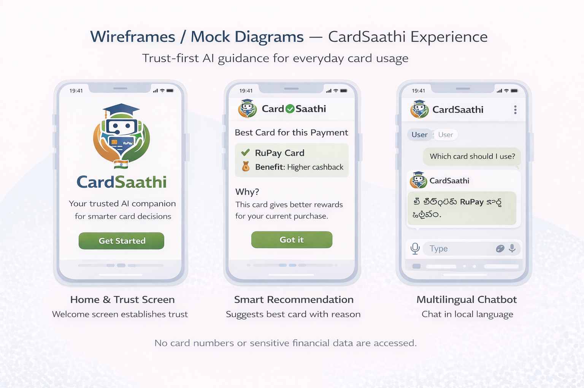
Wireframes/Mock diagrams of the proposed solution (optional)

Slide 7
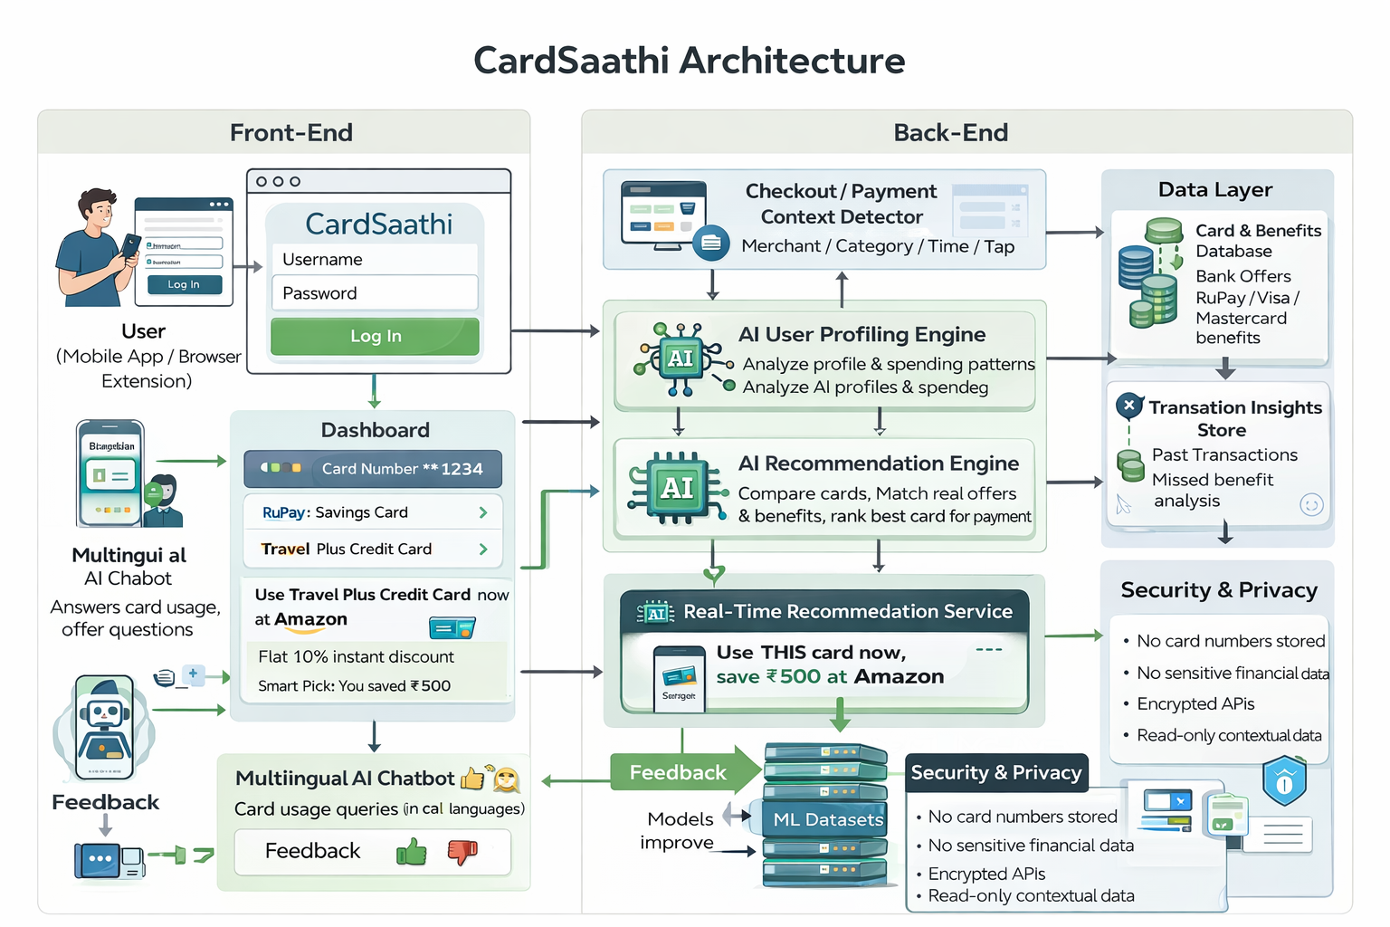
Architecture diagram of the proposed solution

Slide 8
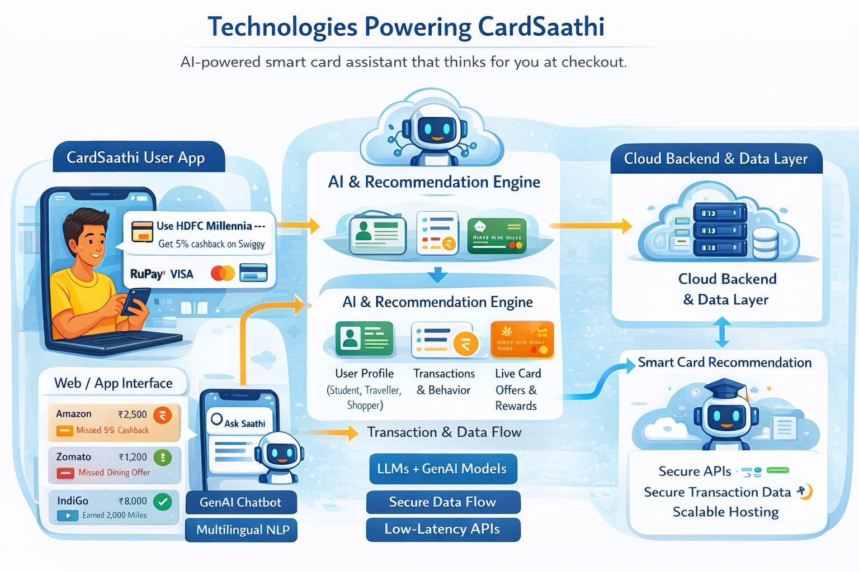
Technologies to be used in the solution:
Smart Front End
Mobile App / Browser Extension – Real-time user interaction & checkout detection
React / Flutter – Fast, clean, responsive UI
Secure Authentication – Username & password login
Multilingual Interface – Built for Bharat, not just English
AI-Powered Back End
Python – Core backend & AI/ML engine
Secure REST APIs – Smooth front-end ↔ back-end communication
AI Recommendation Engine – Instant best-card decisions
Context-Aware AI – Understands merchant, category & timing

Slide 9
Technologies to be used in the solution:
Machine Learning (The Real Power!!)
Supervised ML – Predicts the best card using past transactions
Unsupervised ML – Smart user segmentation (student, traveller)
Reinforcement Learning – Learns from every user action
AI Ranking Algorithms – Maximizes benefits per swipe
ML Datasets
Masked Transaction Dataset (privacy-safe)
Live Card Benefits & Offers Dataset
Merchant & Spending Category Dataset
User Interaction Dataset (clicks, feedback, choices)
Data & Intelligence Storage
Structured Databases – User profiles & card metadata
Analytics Store – Missed benefits & spending insights

Slide 10
Technologies to be used in the solution:
Security & Privacy (Non-Negotiable!!)
Card Data Masking – Only last 4 digits visible
End-to-End Encryption – Secure data flow
Read-Only Architecture – Zero payment access, zero risk
Cloud & Scalability
AWS Cloud – Highly scalable & reliable
Serverless AI Functions – Real-time recommendations at scale
Cloud Databases – Fast, low-latency access
“Powered by AI. Trained on real data. Built for Bharat.”

Slide 11
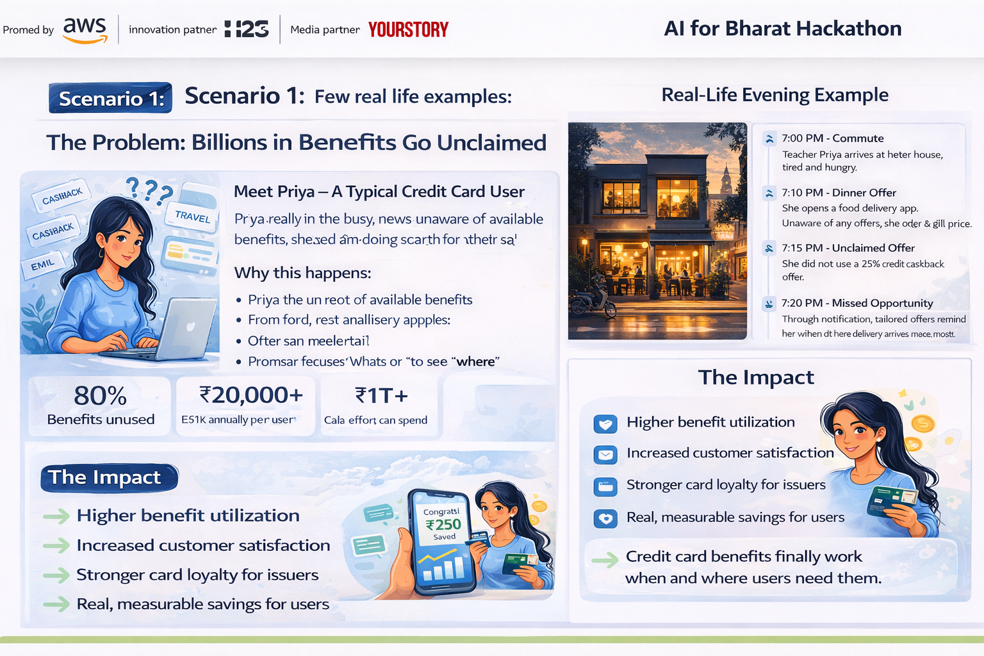
Few real life examples

Slide 12
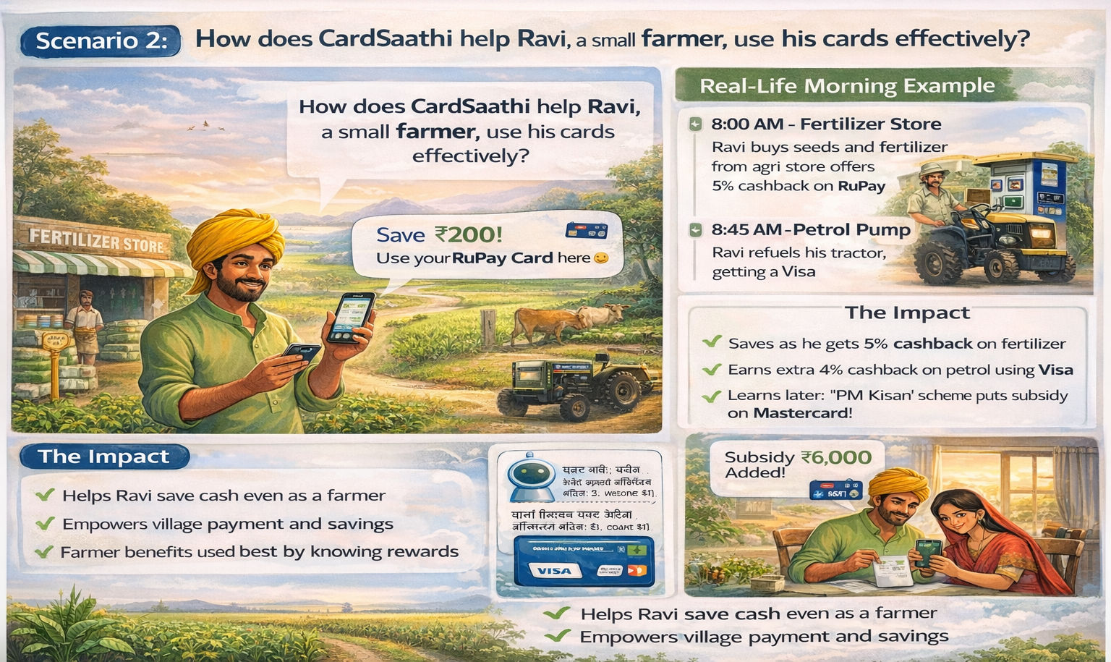

Slide 13
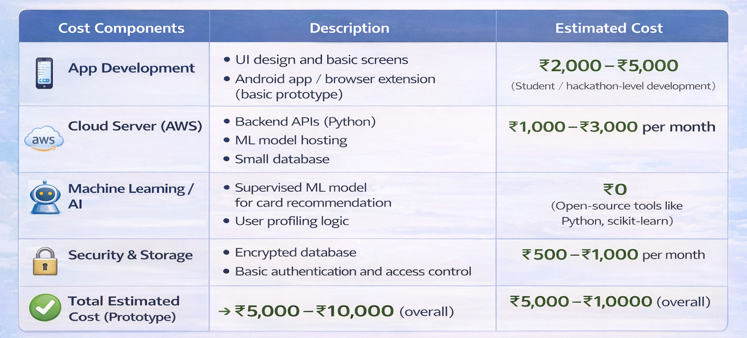
Estimated implementation cost (Prototype):

Slide 14


